Slide 1


Swiss Apprenticeship Model
An Employer Driven System of Education & Training

Slide 2
Swiss Profile
3.2% unemployment
<4% youth unemployment rate
8.2 million population
580,000 businesses
70% of all students choose apprenticeships, no stigma – most CEO's have been apprentices
40% of companies participate in the the program
About 97% of all students have graduated with a VET Diploma (Vocational Education & Training) or other high school degree

Slide 3
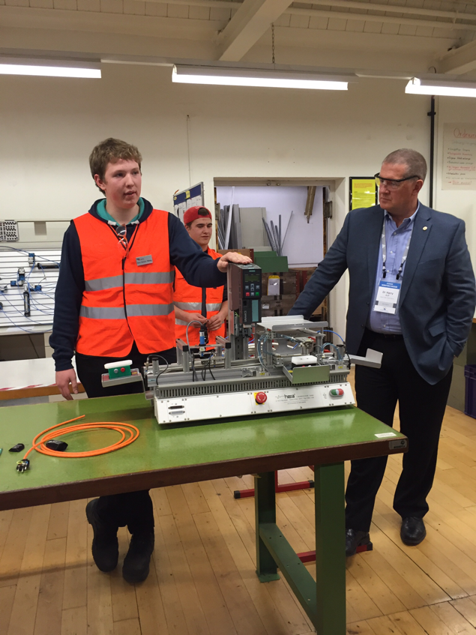
Apprenticeship System
Similar coursework Kindergarten through 10th grade.
Practical work experience education starts at age15 and typically lasts 2-4 years. Hybrid of HS and community college vocational training.
3-4 days/week hands on work experience , 1-2 days/week in classroom
Company nor student are bound to each other after training.
Permeable system that allows youth to choose a career pathway, change industries and move on to specialized certifications or higher education.

Slide 4
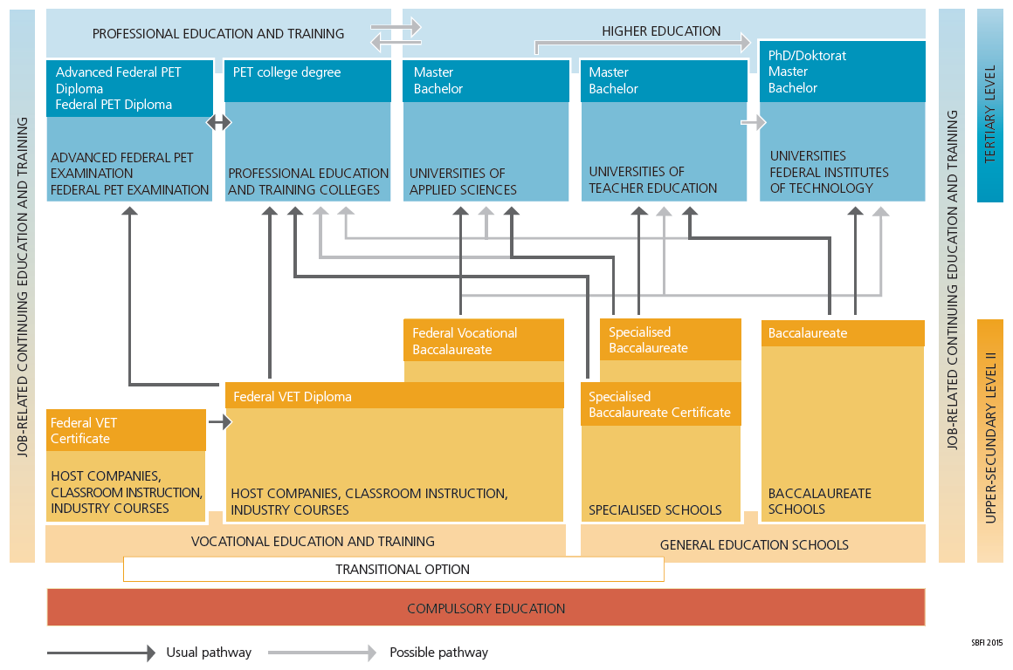
The permeable system allows for all paths to result in whatever degree of education is desired with little to no backtracking, duplicative education, or dead-ends.

Slide 5
The Swiss System- Theory & Practice
Dual track education of theory (classroom) and practice (on-the-job)
VET students earn wages while working for host companies
Companies teach students practical skills related to nationally approved training guidelines
Intercompany training centers provide the “early practice” for students to learn industry specific skills and knowledge

Slide 6
System Elements
Federal responsibilities: system oversight, apprenticeship accreditation and testing
Cantons (states): Local governments similar to our School Districts that are responsible for running the classroom curriculum and providing career guidance to students
Private Companies: Over 230 approved occupations trained in apprenticeships at over 40% of all companies in Switzerland
Many models for private sector training but most industry clusters belong to an association that provides standardized training approved by both industry and government
  Industry Associations include banking & finance, healthcare, technology, transportation, manufacturing, hospitality, etc.

Slide 7
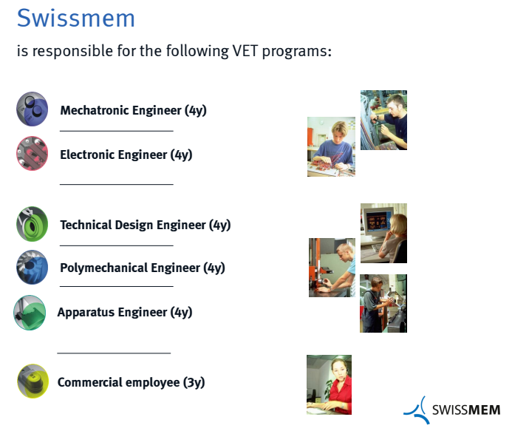
The The Role of Associations
SwissMEM is Switzerland’s Engineering and Manufacturing Association:
Identify competencies
  Re-evaluate every 5 years
Develop training guides and assessments
  Recognized by Confederation for VET Diploma and Baccalaureate Degrees
Assist in development of apprenticeships
Support trainers within companies
Build and support intercompany training centers and other industry specific schools

Slide 8
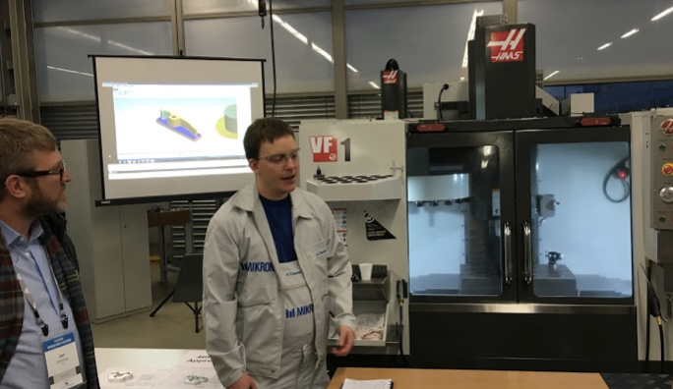
Apprenticeships at
Manufacturer of high precision automated assembly machines
North American Headquarters in Englewood, CO (near Centennial Airport)
World Headquarters in small town of Boudry, Switzerland.
  No manufacturing specific schools near by- created apprenticeship program internally
1/3 of machining production floor is dedicated to apprenticeship training
Only spend a couple months on manual machines at age 15/16 then move on to all CNC

Slide 9
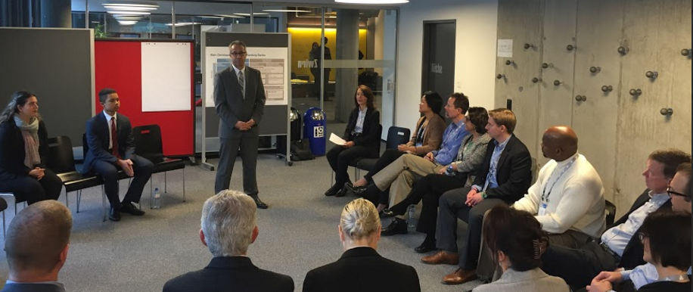
Center for Young Professionals in Banking
Created in partnership by 5 major banks including Credit Suisse and UBS and the Swiss Banker Association
Founded in 2003
70% of all new bankers attend CYP
Provide training to apprentices that are learning to underwrite loans at age 16
Offers career coaching to students prior to apprenticeship
Provides assistance to member businesses for internal training

Slide 10
Business ROI
Savings on recruiting costs
Training to industry standards = savings on retraining = higher productivity
Loyalty to company. Typically 30% stay with training company (or return after college)
Sustainable learning model through paid internships
Aligned supply and demand of skilled workforce = number of apprenticeships dependent on market demand
<4% youth unemployment rate
Costs: depending on industry can be $20,000- $100,000 per apprentice for coaches, curriculum and material/equipment
Canton pays for classroom training (secondary and upper-secondary school)

Slide 11
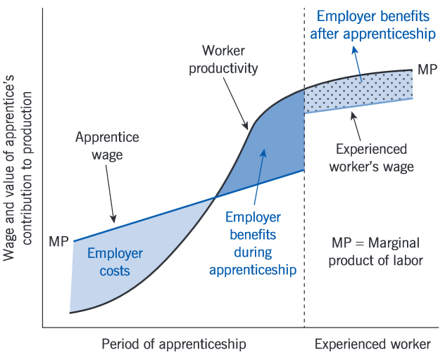
The Business Case
Prof. Stefan Wolter of the University of Bern was able to prove a positive Return on Investment for businesses that host apprenticeships structured appropriately:
Two variables: time and wage
The initial years are always an investment in training, not typically productive
The last half of the apprenticeship should be more productive than the training wage being paid to offset the initial cost
Most companies experience a net zero training cost, or even increased profitability
Other benefits:
  reduced turn-over
  increased loyalty
  increased innovation and productivity
  enhanced team atmosphere
Wage and time are the variables in this model, when structured appropriately,
There is an ROI to industry because apprentices perform productive work as they become increasingly skilled

Slide 12
BASIC: Adapting the Model for Colorado
The Problem
  Colorado’s businesses face an ongoing shortage of skilled workers, making it difficult to identify, hire, and train the talent they need
    Colorado faces ~25,000 unfilled weekly vacancies, resulting in ~$300M annual GDP loss
  Colorado’s current education system is not addressing the State’s growing talent gap in its current form
    The traditional K-12 system provides the academic “theory” for job readiness but not the real-world “practice” to develop job skills
The Solution
  To address this growing problem, Business and Schools in Collaboration (BASIC) facilitates youth apprenticeships that match talent development to the evolving needs
  of businesses
    Businesses and industry associations develop apprenticeships for high demand roles
    In 9th and 10th grade, students undertake a career exploration curriculum
    In 11th and 12th grade, students pursue a paid, part-time apprenticeship
    Students may complete a post-high school training year to receive a certified journeyman status, while obtaining higher education credits
    After program completion, students may continue to work in industry, pursue additional technical training, or continue on to a 4-year degree program
  Apprenticeship programs like BASIC have improved high school graduation rates by 20%+, lowered hiring and training costs for businesses, and increased expected lifetime earnings for participants by 30%+
  By addressing the need for expanded apprenticeships starting in high school, we are also expanding the infrastructure for apprenticeships for all Coloradans.
  BASIC needs substantial funding over the next 3 years to stand up a core staff and establish the next 500 business partnerships across Colorado

Slide 13
Colorado’s businesses struggle to fill key positions, raising the cost of finding and hiring critical talent
Colorado currently has 25,000+ unfilled jobs a week
Colorado unfilled jobs,
000s
2016
“Our tool room manager is 70 years old and we can’t find talent to back fill him. Our newest hire came from Ohio.”
Noel Ginsburg, CEO Intertech Plastics
Healthcare
Hospitality/Tourism
Manufacturing
Banking/Finance
Information Technology
“Our current system of career and technical education and middle skills training will not sustain the needs of our business… We are in a crisis for finding and developing skilled talent,”
Jon Kinning, COO of RK Mechanical
Commercial Services
Total
The inability to fill key positions costs Colorado ~$300M in annual GDP
Absence of critical skills in CO labor pool has raised cost of scouting/hiring/training
2016
Projected hiring and training costs for skilled-roles
$,000s
Colorado GDP
24
25
26
28
29
$, M
2016
2017
2018
2019
2020
Source: CO Dept. of Labor; Center for American Progress Jobs Training Report; Team Analysis

Slide 14
Colorado’s traditional education system leaves some students without a clear and integrated path into the workforce
100
9th graders begin high school
77
students reach graduation
23 do not graduate
44
44 enroll
in college
33 do not enroll
Works for only
18% - 23%
of students
35
35 Students return
for a second year
Colorado’s Education System
9 do not return
23
23 Students receive a post secondary degree within 150% of allotted time (Certificate, associates
or bachelors)
12 do not
18
immediately enter employment in Colorado
Colorado’s traditional talent pipeline falls short
of preparing the talent needed by business to be globally competitive
SOURCE: The Colorado Talent Pipeline Report 2015

Slide 15
BASIC links Colorado’s emerging talent with businesses through meaningful apprentice roles and career exploration
Example BASIC approach, Grades 9-12 + post-secondary
Freshman
Expose
Sophomore
Navigate
Junior Connect to Apprenticeship
Year 12 (Community College)
Year 13 (Community College)
Tier 1 Courses:
Intro and Survey
Tier 2 Courses: Specialized
Tier 3 Courses: Specialized
Tier 4 Courses:
High School Diploma
Tier 5 Courses:
Completion
Career Explorations Group Job Shadow Program
Career Coach Mentoring
Pre-Apprenticeship Program
Apprenticeship Program
Ongoing mentorship and support
  BASIC aspires for students to complete apprenticeship with the option to:
Earn industry certifications and college credit
Pursue an associate’s degree
Gain preferential transfer admissions into competitive 4-year programs
Secure industry certifications where applicable
Directly enter a sustainable high skill career

Slide 16
BASIC gives Colorado businesses the tools they need to develop a highly skilled workforce
What BASIC does
Why BASIC works
1
  Turns Colorado’s companies into Centers of Learning, allowing students to convert theory into practice through career exploration and apprenticeships
  Reduces all-in employee hiring and training cost by 20%+¹
  Remains ROI neutral for participating businesses due to student productivity ²
  Delivers 23X lifetime return³ on taxpayer dollars invested in education and workforce training
  Provides program graduates with a median annual wage of ~$50,000^{4,5}
  Increases participants’ high school graduation rate from 77% to 93%^{6,7,8}
2
  Creates industry-specific talent pipelines by defining the competency standards and curriculum needed to prepare for high-demand jobs
3
  Connects businesses and schools, linking talent development with an ever-changing labor market
1 Boushey and Glynn “There are Significant Business Costs to Replacing Employees” 2012. 2 Canadian Apprenticeship Forum, “It Pays to Hire an Apprentice: Calculating the Return on Training Investment for Skilled Trades Employers in Canada” 2009. 3 Hollenbeck 2012 Washington workforce training results by program. 4 US Department of Labor Employment and Training Administration. 5 Washington State Workforce Training and Education Coordinating Board: Significant variation in median wages for apprentices exists; apprenticeship participants’ median wage is $28.61 while the lowest quartile earns $17.85 and highest above $38.40. 6 CO Dept of Education. 7 US Dept of Education. 8 Civic Enterprises et al., Building a Grad Nation: Progress and Challenge in Ending the High School Dropout Epidemic: Annual Update, 2015

Slide 17
BASIC matches talent development to talent need and puts business in the driver’s seat
  Government:
  Provide legislative support, incentives, and funding; support the standardization of
  BASIC across Colorado
  High-level vision and coordination from BEL Commission
  Develop and expand sector partnerships
  Build on existing models
Businesses:
  Provide apprenticeship opportunities for students to blend theory and practice
  Gain certification as Centers of Learning (C-COLs) to host and hire apprentices
  Fill talent pipelines through engaging career exploration and apprenticeship training
  Support student recruitment/outreach in region
  Develop industry competency standards and curricula based on talent needs
  Post-Secondary Education:
  Partner to help determine appropriate higher education pathway for
  each student
  Facilitate stackability of work-based and classroom-based credits
  Adjust content focus to reflect evolving industry competency standards
  and curricula
Schools:
  Teach the theory that underpins industry practice
  Provide career counseling, guidance and exploration opportunities
  Facilitate entry into apprenticeship programs
  Assist in the development of and evolution of competency-based curriculum
  Industry Associations:
  Develop competency standards and curricula
  Leverage sector partnerships to deepen involvement and connections in all regions
  Provide C-COLs with training protocol and guidelines
Community-Based Organizations and Workforce Centers:
  Provide complementary services and programs to support students
BASIC improves Colorado’s talent pipeline by building an aligned, compatible system of skills-based certifications, credentials & degrees

Slide 18














BASIC is positioned to play a key role in Colorado's emerging workforce development ecosystem
  Regional, industry led sector specific, public-private partnerships
  Address common, critical issues, and implement solutions
  Network of businesses and schools for K-12 workplace learning
  Statewide infrastructure for industry engagement
Sector
partner-
ships
  A series of connected education and training programs, work experiences, and student support services, driven by industry.
Statewide Industry Assn’s
Career
Pathways
  Career and technical programming in schools
  Governor’s platform to champion workplace learning
BASIC will build on Colorado’s emerging workforce development infrastructure
BEL
Com-mission
Career
& Technical
Education
  Supports career training for opportunity youth (age 16-24, out of school and work)
Post-Secondary Workforce Readiness
  Concurrent Enrollment; ASCENT; Grad Guidelines tools to help high school students begin college credits up to an Associate’s Degree in High School
Opportunity
Youth

Slide 19

















Leading businesses across the state have partnered with BASIC
BASIC sectors
Partners
Business
As a business-led initiative, designed to respond to an ever-changing economy and labor market, BASIC operates independently of Colorado’s political and economic cycle
Industry Intermediaries
Education
Community
*
Government
1 Partnership in progress

Slide 20
Over the next 10 years, BASIC will evolve from the pilot phase to national leadership in talent development
Stage 5
Sustain
(2024-)
To move from Stage 2 to Stage 3, BASIC must stand-up a full time organization with strong program and relationship management capabilities
Stage 4
Scale
Statewide
(2020-2024)
Stage 3
Initial
Implementation
(2017-2020)
  Continue to facilitate business community leadership in work-force training
  Respond to a changing economy and labor markets by updating and adjusting training annually
  Support efforts to build a national apprenticeship model by sharing lessons learned across the U.S.
Stage 2
Pilot
(2016)
  Move toward industry-funded, sustainable model
  Fill 20,000+ apprentice positions across Colorado
  Refine, test and share competencies at the national level
Stage 1
Design
(2015)
  Certify 500 business partners in 6 sectors as centers of learning
  Grow apprenticeships and sectors as economy evolves
  Creation of an apprenticeship marketplace
  Engage 6000+ students in DPS CTE programs
  Continue building Skillful, the competency- based labor market
  Recruit and on-board industry associations, sector partnerships and business partners
  Begin measuring to evaluate the impact of apprenticeship system
  Identify initial business partners
  Build pathways from business to students
  Define initial sectors and required competencies
  Build initial organization model and start-up team
  BASIC is ready to move from the design and pilot phase to
  broader implementation across the State of Colorado

Slide 21
Thank you for your time.
Please email info@basic.org for more information

